Slide 1

Taking Control: Real-World Use Cases of Customer-Managed Insurance Platforms with Accessible AI

Slide 2



Introductions and Agenda
Overview of Spear Technologies
Architecture and Advantages of Client Custom Layer
Customer Managed Hosting Model Explained
Leveraging AI Models Within a Core Insurance Suite
Client Case Study of AI Usage in SpearClaims
Demonstration of SpearSuite’s Design and Deployment
Patrick O’Neill
Founder & President
Redhand Advisors
John Carolan
SVP, Business Development
Spear Technologies
Jose Tribuzio
CTO and Co-Founder
Spear Technologies

Slide 3
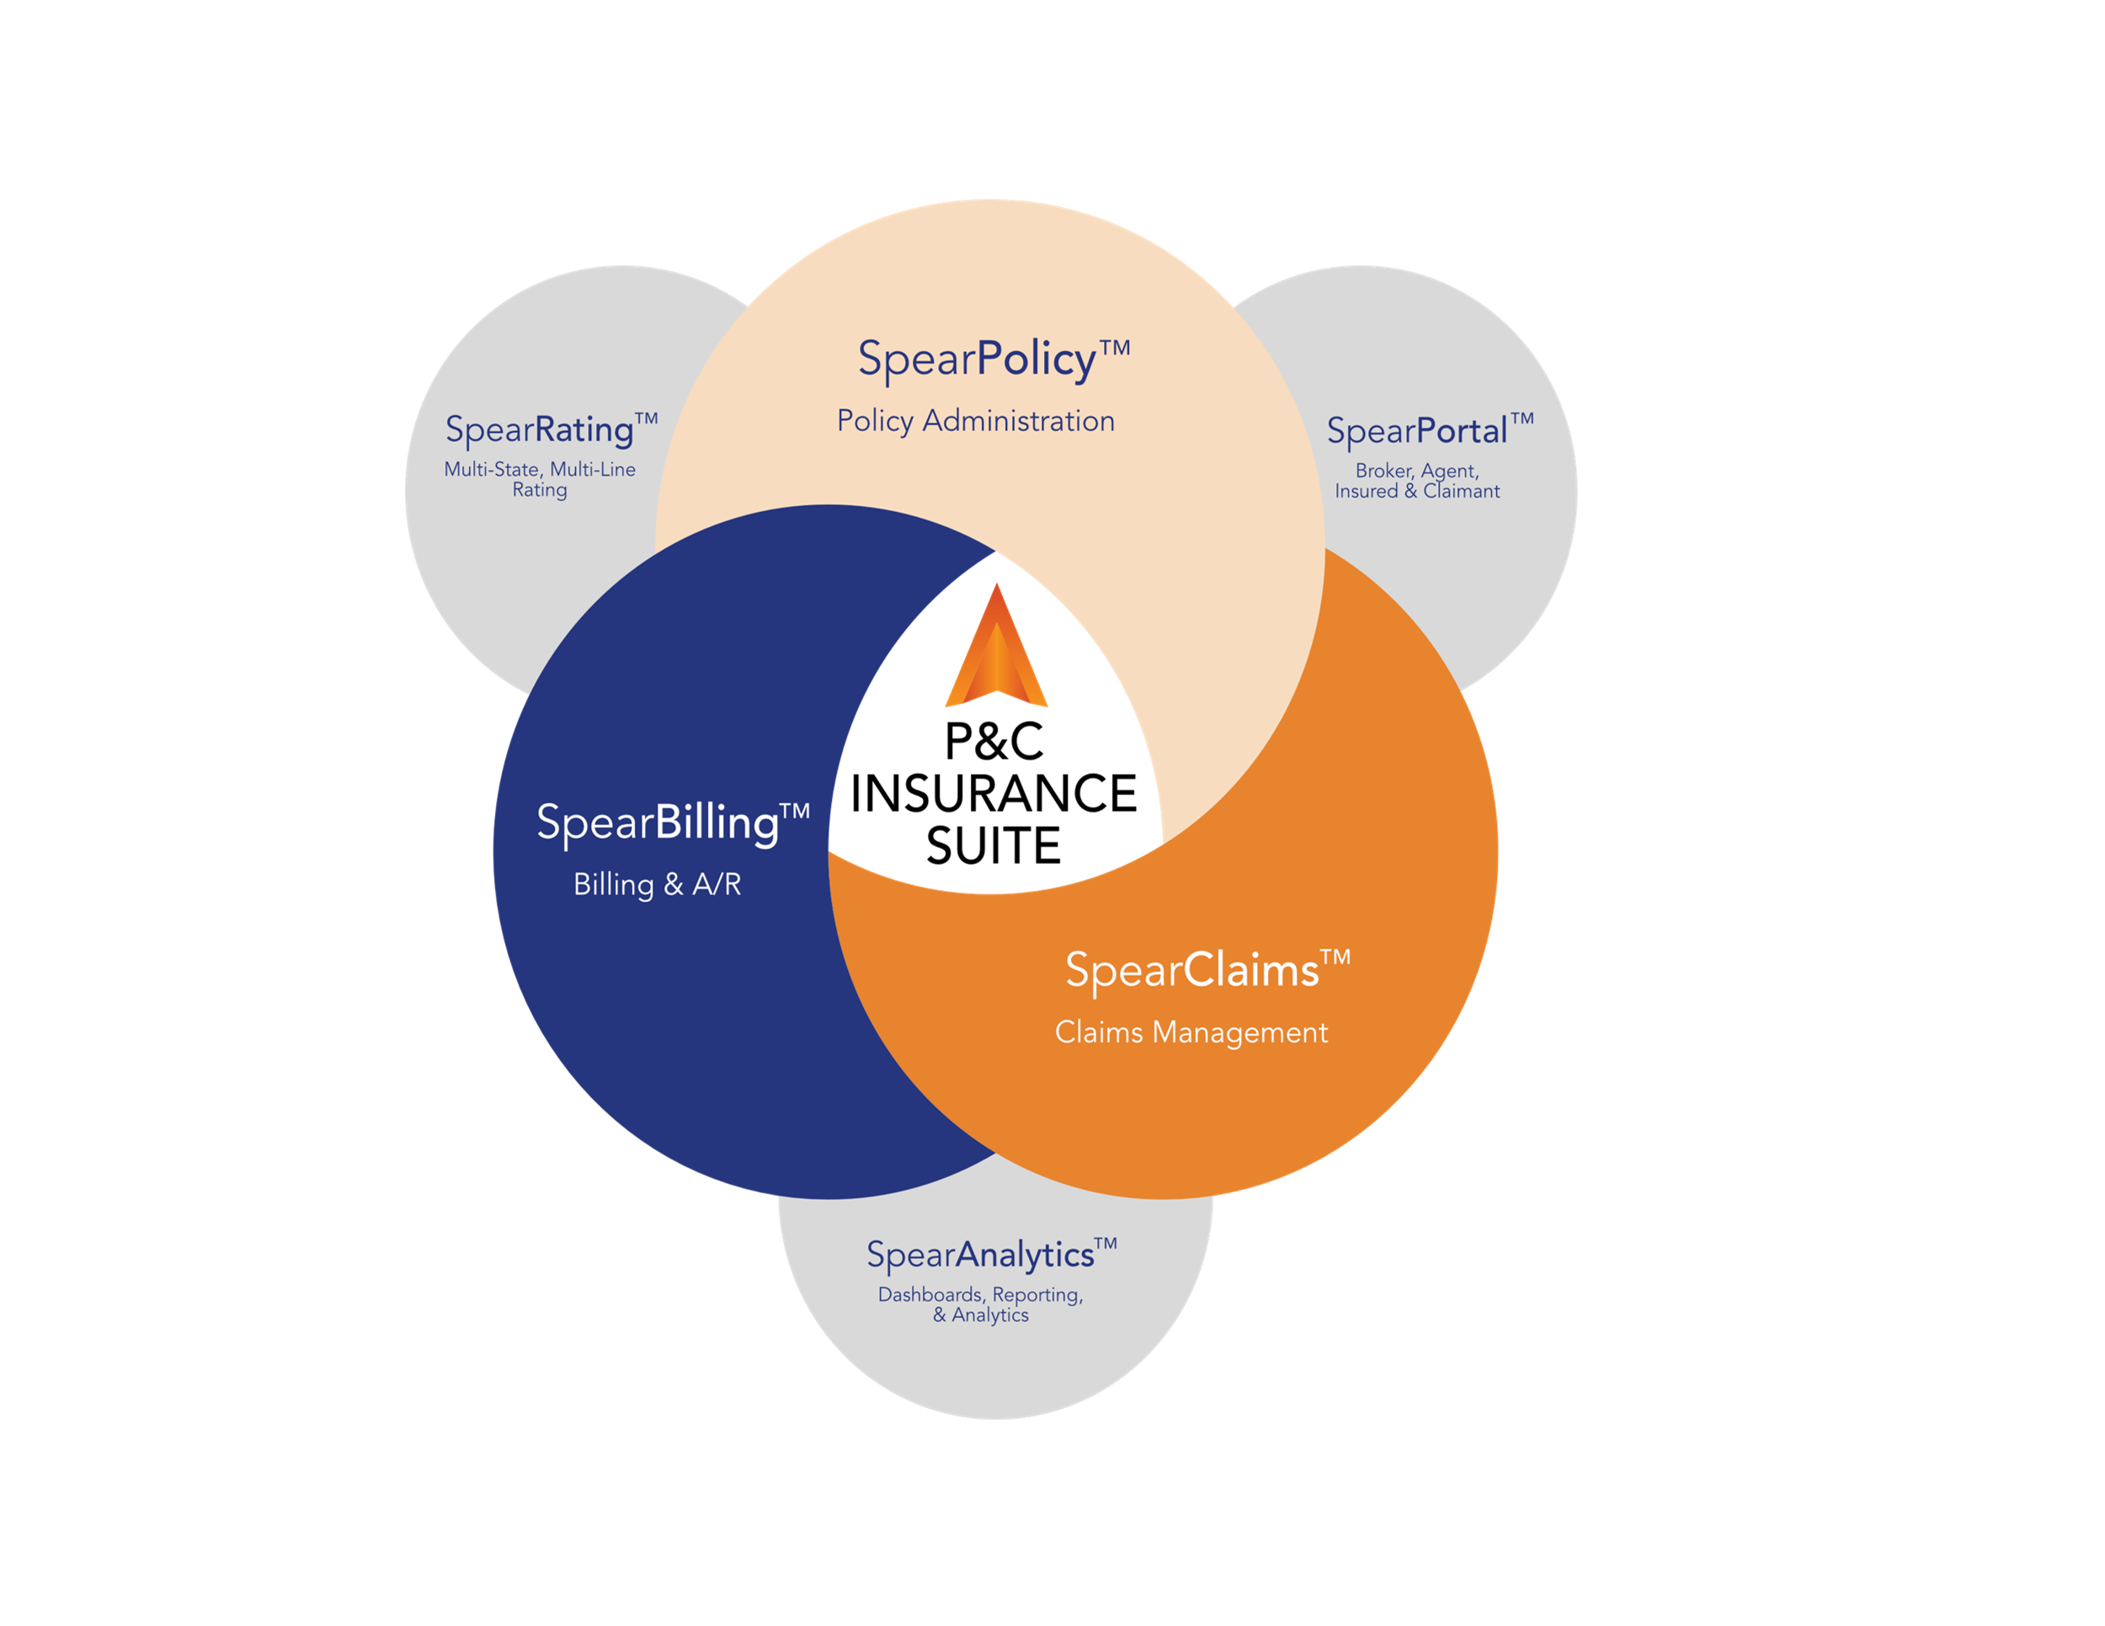

Comprehensive Suite of P&C Software Solutions
Core Suite
Technology
benefits
Designed by industry experts on a modern, low code platform
Incorporates built-in AI, deep analytics, and intelligent automation
Achieve better results with more control of your operations at a lower total cost of ownership

Slide 4










The Spear Advantage
Cutting-Edge Analytics & AI
Actionable insights and predictive outcomes
Secure & Scalable Cloud Platform
Industry-leading security on Microsoft Azure
Flexible & Extensible
Unmatched customization through low-code options
Purpose-Built for Insurance
Developed specifically for P&C insurance
Deep Insurance Expertise
Industry thought leaders with decades of experience
Spear Technologies was recently named a Technology Standout by a leading insurance analyst. Our solutions lead the industry in performance, security, capability, and ease of use while keeping our solutions affordable for organizations of all sizes.

Slide 5



Customization & Scalability
System Layer (Managed)
Licensed SpearSuite solution with core functionality
Administrator Control
User administration, roles, permissions, templates, business rules
Client Custom Layer (Unmanaged)
Custom fields, layouts, screens, and features configured by our clients
The power of the Microsoft Power Platform truly shines in the unmanaged layer, where clients can customize SpearSuite to meet specific needs without traditional coding or new software releases. Hosted on Microsoft Azure, the
platform leverages industry-leading security, compliance, reliability, and scalability to support growth, with
33 million monthly active users across the Microsoft Power Platform.

Slide 6
Customer-Managed Hosting Model
Greater Control & Flexibility
Core Microsoft Components
Spear clients manage their own Microsoft tenant with direct oversight over user access, updates, and licensing, providing more transparency and administrative control.
This model is ideal for organizations with strong in-house IT or Microsoft expertise who value autonomy and governance over their software stack.
Microsoft Power Apps & Power Automate
Azure Active Directory for Authentication
OneDrive for Business for document scanning
Azure Blob Storage for document hosting
Azure SQL with Power BI Premium for reporting
Azure Virtual Machine for utility services
The Customer-Managed Solution places infrastructure control and Microsoft Power Platform licensing in our client’s hands rather than bundling it with Spear's services. All Microsoft services used adhere to high compliance standards like HIPAA, SOC 2 Type II, and GDPR, while allowing Spear clients to enforce their own security policies.

Slide 7



Security, Privacy & Compliance
Role-Based Security
Data Encryption
SOC 2 Type II Compliant
Team and role-based permissions determine what actions users can perform and what data they can access, with different levels of access to applications and data.
Data encrypted at rest using Azure Key Vault, data encryption keys, and key encryption keys ensuring confidentiality of all PHI/PII hosted in the environment.
Meets System and Organization Controls requirements for security, availability, confidentiality, and processing integrity through regular testing and audits.
SpearSuite includes comprehensive security controls including staff security training, multi-factor authentication, role-based access, security patch management, third-party security testing, data encryption, intrusion prevention, and centralized security logging for review and audit. Microsoft’s SLA includes an Uptime Guarantee of 99.9% availability.

Slide 8
AI Capabilities via Power Platform
Copilot for Model-Driven Apps
Embedded in SpearSuite to guide users through processes, answer natural language questions, and generate data insights.
Supports natural language to action — e.g., “Show open claims over $50k” produces filtered views instantly.
AI Builder
No-code AI model creation for classification, prediction, object detection, and document processing.
Integrates with SpearSuite to automate claim document intake, policy form recognition, and image analysis.
Prebuilt models (e.g., sentiment analysis, notepad/document summaries, key phrase extraction) ready to use.
Natural Language Query & Data Exploration
Users ask questions in plain English; the system translates them into Dataverse queries.
Interactive charts and summaries generated dynamically for claims, loss control, underwriting, and billing data.
Predictive Analytics
Build and deploy predictive models to forecast claim costs, predict litigation, detect fraud, or identify subrogation.
Real-time scoring within the workflow for proactive decision-making.
Process Automation with AI
Combine AI insights with Power Automate to trigger next-best actions.
Examples: route complex claims to specialized users, auto-populate policy data from scanned forms.
Integration with Azure OpenAI
Extend capabilities with GPT-based summaries, document drafting, and conversational bots.
Embed advanced AI into SpearSuite business processes without custom code.

Slide 9
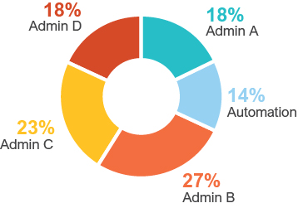
Client Case Study
AI Prompt Sample:
The claimant's workers' compensation claim has seen various developments, including approvals and denials regarding settlements and benefits.
05/04/22: WCC approved the Agreement of Final Compromise and Settlement, subject to a 6.5% assessment for the Subsequent Injury Fund and a 2% assessment for the Uninsured Employers' Fund, payable within 30 days.
03/07/22: Settlement denied due to lack of MSA records and annuity information.
9/04/13: Commission lacked jurisdiction to hear the temporary total disability issue due to ongoing appeal related to psychiatric treatment.
8/02/13: Vocational rehabilitation authorization denied; claimant secured a job deemed suitable by her treating doctor.
4/03/13: WCC awarded additional temporary total disability compensation of $542/week from June 20 to July 19, 2012, and ordered medical treatment for the claimant's shoulder and arm.
3/20/13: WCC approved the Vocational Rehabilitation Plan.
Plan of Action: The claim is currently pending compensability for injuries to the neck, right knee, right ankle, left thumb, and headaches. A new hearing date is awaited, with the next scheduled for 01/16/25.
Claimant/Injury Detail: The claimant, who was hired on 03/06/2019, sustained a sprain to the left thumb and injuries to the right knee and ankle after slipping on a wet step. Claimant attorney John Smith represents him, while defense attorney Minnie Mouse is handling the case.
Current Status: The claimant returned to light duty work on 10/04/24 and is currently attending physical therapy. The legal status remains pending with a hearing to contest the listed body parts, and settlement potential is not recommended at this time.
Core Services: Third-Party Claims Administration, Data Solutions, Risk and Claim Consulting
TPA Lines of Business: WC, GL, PL, AL, EPL, Cyber, Property, DO & more
464,588
Claimants in System
60
System Users
15,000+
Paper Documents Received since 1/1/25
26,500+
Payments issued since 1/1/25
Approximately
90 hours
of work saved
2 Custom AI Prompts in Use
Summarizing certain note types
Summarizing Claim Review Notes
12 Custom AI Builders in Use
Indexing Invoices to Claim Files
Entering payments based on invoices
Paper Mail – Filing to Claim

